Slide 1

Travel Planning App
planning trips simply
Debanjan Basak

Slide 2
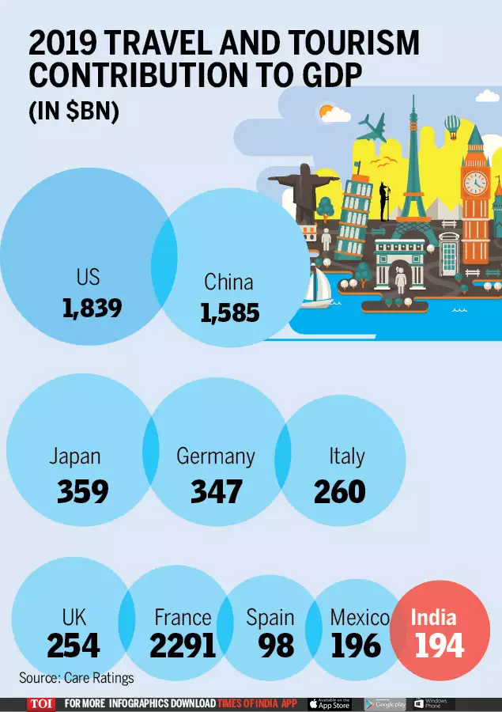
Tourism Industry at a Glance
Tourism offers great opportunities for emerging economies and developing countries.
It creates jobs, strengthens the local economy, contributes to local infrastructure development.
Help to conserve the cultural assets and traditions.
Local people are able to benefit from the income opportunities arising from tourism.
It contributes 6.23% to the national GDP and 8.78% of the total employment in India.
Still we are not able to make full use of this industry as compared to other countries.

Slide 3

Problems ?
A lot of research needs to be done before planning a trip
Difficult to plan an organized trip
Hard to choose where to go
What are the requirements for the trip?
Difficulty in finding the right transportation
and routes to travel in the best possible way.
Managing a trip budget is difficult.

Slide 4



Target Audience
anyone planning a trip
Student - College trip
Working man - Family trip
Retired man - enjoying

Slide 5





Competitor Research
 | Tripit | Wanderlog | Tripadvisor | Booking.com | Goibibo
Platform | iOS/Android | iOS/Android | iOS/Android | iOS/Android | iOS/Android
Free/Paid | Free ($49 per year for Premium) | Free ($49 per year for Premium) | Free ($99 per year for Premium) | Free | Free
Target Audience | Travellers | Travellers | Travellers | Travellers | Travellers
Revenue Model | Paid Apps Revenue | In – app purchase | Paid Apps Revenue | In – Apps purchase | In – App Purchase
Main Features | Organizes travel plans | Travel planning app | Details & reviews of places | Online travel booking | Online travel booking
Key User Experience | Easy to manage trips | Provide places suggestions | Provide trip information | Good for travel booking | Good for travel booking
Major Pain Points | Does Not Suggest Places to Visit During Your Trip | Manual entry for itinerary | Some reviews are biased | Only used for bookings | High convenience fees
Customer Review Ratting/ Comments | 4.8 out of 5 | 4.9 out of 5 | 4.8 out of 5 | 4.8 out of 5 | 4.6 out of 5

Slide 6

Research
Travel and tourism apps are 7th most downloaded category of apps.
Despite having so many apps and websites, people still spend more time planning a trip.
as travel information scattered across multiple apps and sites.

Slide 7

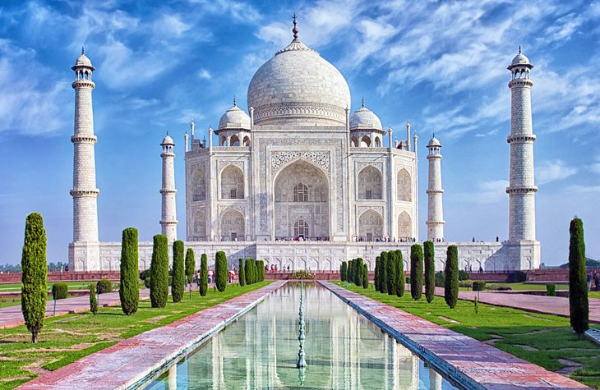



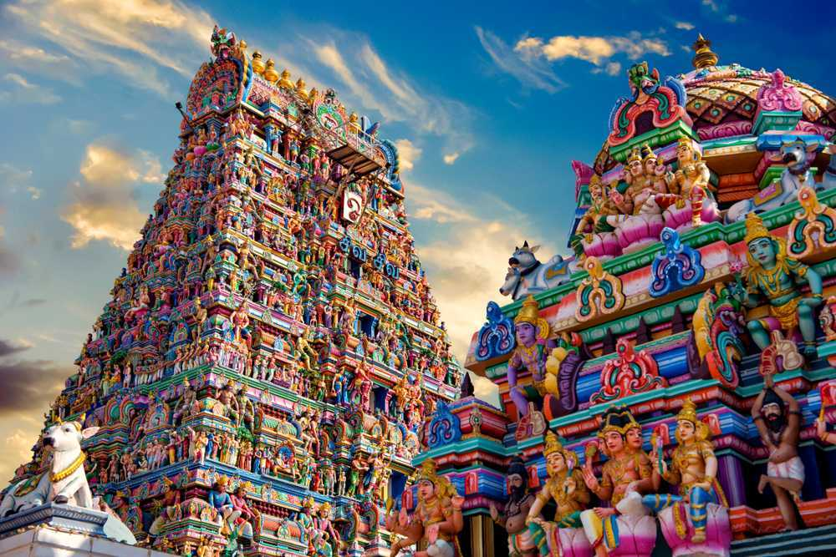
Auto - Itinerary Generator
one plan does not suit everyone
Customised tour plan according to user preferences.
Detailed – things to do – must sea, top activities, places to explore
recommend transportation and accommodation
local food recommendation – experience the local life
suggested local stores and business – buy souvenir to make trip memorable
requirements for the trip
weather updates
different languages
Ordered – optimized routes, automatically rearrange the best route
Manage budget – provide best possible trip.
Further edit the itinerary
Book tickets – directly from source
Share itinerary with friends and family
Geo tracking will be provided
Sync plan with calendar.

Slide 8
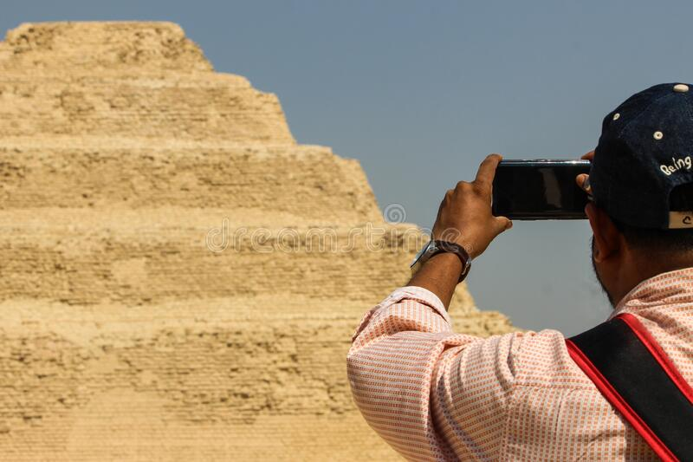


Ask the expert
Want to know more about the place ?
connect with our expert guides
upload image of that place
ask doubts
Got stuck or facing any issue ?
Raise an alert
Lost way
Health related problem
Our experts will provide the best guidance.

Slide 9
Purpose
Creating traveling experiences for tourists rather than just attractions
Traveling is an experience rather than just visiting attractions!
built up experiences and memories to take back home.
Visit the Unseen and unexplored
We still need to explore the unseen and the unexplored!
Promoting culture and tradition of that place
Every destination has its own unique story.
So let us just make them more popular and tourist-friendly to offer a best experience to the travelers.

Slide 10
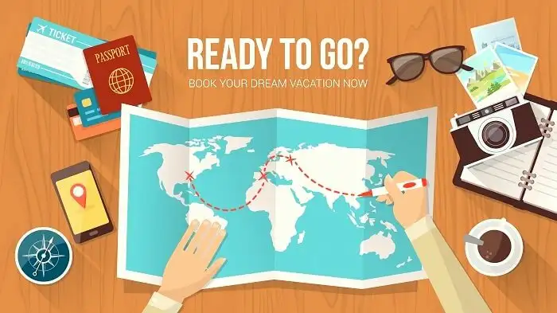
Thank You

